Slide 1
PULSE RATE SENSING WITH ARDUINO
Presented By : Niraj Khankari

Slide 2
PULSE RATE (BPM) MONITOR USING ARDUINO & PULSE SENSOR OVERVIEW
In this project, we will interface Pulse Sensor with Arduino to Measure Pulse Rate (BPM) or Heart Beat value. The Pulse rate will be displayed on 16×2 LCD Display.
A pulse sensor is a hardware device that can be used to measure heart rate in real-time. When paired with an Arduino microcontroller, you can create a simple yet effective heart rate monitor. This sensor is quite easy to use and operate. Place your finger on top of the sensor and it will sense the heartbeat by measuring the change in light from the expansion of capillary blood vessels.
.

Slide 3
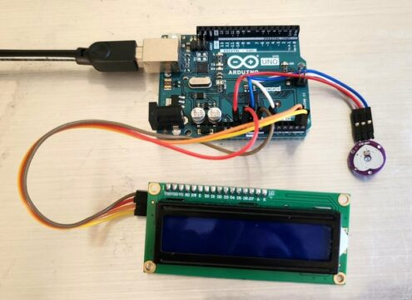
COMPONENTS/HARDWARE REQUIRED
Arduino Uno
Pulse Sensor
LCD Display 16*2
I2C Module
Jumper Wires
BreadBoard (if necessary)
Female Connector

Slide 4
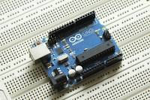
ARDUINO UNO : -
The Arduino Uno is a popular microcontroller board based on the ATmega328P microcontroller. It has 14 digital input/output pins (of which 6 can be used as PWM outputs), 6 analog inputs, a 16 MHz quartz crystal, a USB connection, a power jack, an ICSP header, and a reset button. It can be programmed using the Arduino Software (IDE). The Uno board is a great choice for beginners and experienced users alike.

Slide 5
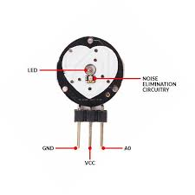
PULSE SENSOR : -
The pulse sensor is a small, low-cost sensor designed to detect the heartbeat and measure the heart rate of an individual.
1. Function: The pulse sensor measures the variation in blood volume through the skin, typically at the fingertip or earlobe. This variation is caused by the pulsing of blood as a result of the heart's contractions.
2. Components: The sensor typically consists of an optical sensor to detect blood flow and a light source (usually an LED) that illuminates the skin. It may also include amplification and signal conditioning circuitry to process the detected signal.
3. Output: The sensor provides a real-time output of the heart rate, usually in beats per minute (BPM). This output can be used for various applications, such as health monitoring, fitness tracking, and medical diagnostics.

Slide 6
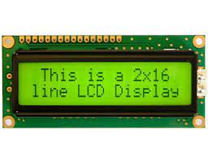
LCD DISPLAY : -
An LCD display with a resolution of 16x16 means that it has 16 rows and 16 columns of pixels, resulting in a total of 256 pixels. This type of display can be used to show simple graphics or text, and it's often found in small electronic devices such as digital watches, calculators, and some industrial equipment. Keep in mind that specific details about a particular LCD display, such as the communication protocol it uses, the color depth, and the available interfaces, may vary, so it's always best to consult the manufacturer's specifications for accurate information.

Slide 7
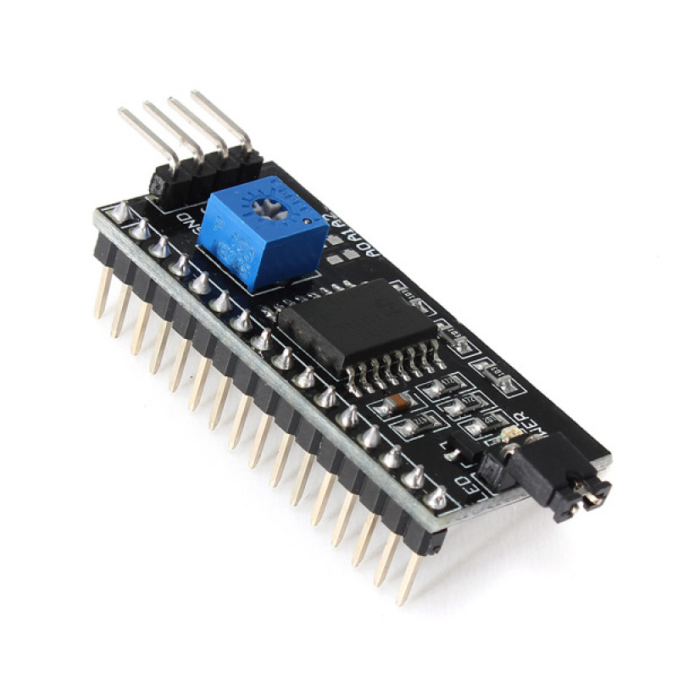
IC MODULE : -
The IC module used for driving LCD displays are typically a form of driver/controller IC specifically designed for interfacing with liquid crystal displays. Some common ICs used for this purpose are the HD44780, KS0066, and the ST7066. These ICs are designed to provide easy interfacing between a microcontroller or other system and the LCD display, handling tasks such as generating the required waveforms, providing character generation and control, and managing the display's overall operation. They usually support standard interfaces such as parallel or serial communication to enable easy integration into a wide range of systems.

Slide 8
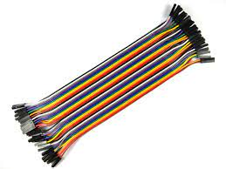
JUMPER WIRES : -
Jumper wires are simple electrical wires used to create connections between electronic components, such as connecting a microcontroller to a sensor or connecting components on a breadboard. They typically consist of a single insulated conductor with a connector or pin on each end for easy insertion and removal. Jumper wires are available in various lengths and colors to facilitate different wiring tasks.

Slide 9
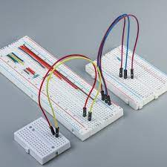
BREADBORAD :-
A breadboard is a tool used in electronics and prototyping to create temporary circuits. It consists of a grid of holes into which electronic components can be inserted, and the connections are made using metal strips underneath the surface of the board. This allows for easy and quick construction of circuits without the need for soldering.

Slide 10
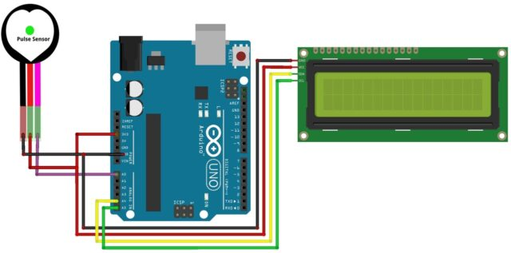
HARDWARE WIRING DIAGRAM

Slide 11
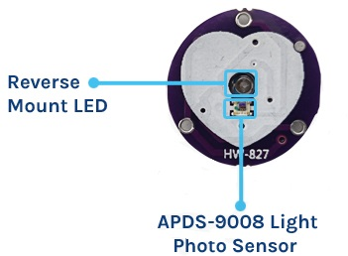
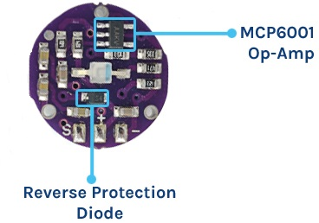
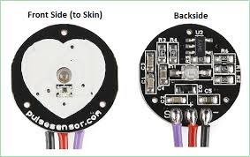
PULSE SENSOR
THE PULSE SENSOR IS A PLUG-AND-PLAY HEART-RATE SENSOR FOR ARDUINO. IT CAN BE USED BY STUDENTS, ARTISTS, ATHLETES, MAKERS, AND GAME & MOBILE DEVELOPERS WHO WANT TO EASILY INCORPORATE LIVE HEART-RATE DATA INTO THEIR PROJECTS.
THE ESSENCE IS AN INTEGRATED OPTICAL AMPLIFYING CIRCUIT AND NOISE ELIMINATING CIRCUIT SENSOR. CLIP THE PULSE SENSOR TO YOUR EARLOBE OR FINGERTIP. THEN IT INTO YOUR ARDUINO, YOU ARE NOW READY TO READ HEART RATE.

Slide 12
PULSE SENSOR TECHNICAL SPECIFICATIONS
PHYSICAL CHARACTERISTICS
ELECTRICAL CHARACTERISTICS
SENSING TECHNOLOGY
Dimensions: Approximately 0.625″ (15.875mm) in diameter
Weight: Lightweight, usually around a few grams
Material: Biocompatible materials for safe skin contact
Operating Voltage: 3V – 5.5V
Current Consumption: Typically around 4mA
Output Signal: Analog (0.3V to VCC)
Signal Range: 0-1023 (10-bit ADC output of Arduino)
Sensor Type: Photoplethysmogram (PPG)
Wavelength: Typically around 565nm (Green LED)

Slide 13
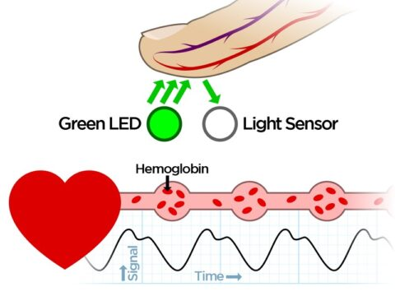
WORKING OF THE PULSE SENSOR
The Pulse Sensor works on the principle of Photoplethysmography (PPG), which is a non-invasive method for measuring changes in blood volume under the skin. The sensor essentially consists of two main components: a light-emitting diode (LED) that shines light into the skin and a photodetector that measures the amount of light that is reflected back.

Slide 14
PROPOSED METHODOLOGY
1. **Research and Component Selection**:
- Conducted thorough research from various internet sources to gather information about required components for the project.
- Studied specifications of essential components such as Arduino Uno, Pulse Sensor, LCD Display, etc.
2. **Understanding Pulse Sensor Technical Specifications**:
- Analyzed the physical and electrical characteristics of the Pulse Sensor:
- Dimensions: Approximately 0.625″ (15.875mm) in diameter.
- Operating Voltage: 3V – 5.5V.
- Signal Range: 0-1023 (10-bit ADC output of Arduino).
- Explored sensing technology details:
- Sensor Type: Photoplethysmogram (PPG).
- Wavelength: Typically around 565nm (Green LED).

Slide 15
3. **Understanding the Working Principle of Pulse Sensor**:
- Researched and comprehended the working principle of Photoplethysmography (PPG).
- Explored the main components and their functions:
- Light Emission: Green LED emits light into the skin.
- Reflection & Detection: Photodetector captures partially reflected light interacting with blood.
- Heart Rate & Oxygen Level Measurement: Changes in reflected light correlate with heartbeats and indicate blood oxygen levels.
- Signal Processing: Low Pass Filter and operational amplifier clean and amplify the signal for accurate readings.
- Data Processing: Arduino reads the amplified signal and translates it into heart rate and potentially blood oxygen levels using software algorithms.
4. **Identification of Potential Applications**:
- Identified various applications of the Pulse Sensor technology, including:
- Sleep Tracking.
- Anxiety Monitoring.
- Remote Patient Monitoring or Alarm System.
- Health Bands.
- Complex Gaming Consoles.

Slide 16
5. **Justification**:
- The step-by-step methodology ensures a systematic approach to understanding the technical specifications and working principle of the Pulse Sensor.
- Researching and selecting components based on specifications ensures compatibility and functionality within the project scope.
- Understanding the working principle provides insights into how the sensor captures physiological data, ensuring accurate interpretation and utilization.
- Identifying potential applications demonstrates the versatility and relevance of the Pulse Sensor technology in various domains, justifying its inclusion in the project.
This structured methodology lays the foundation for further development and implementation of the Pulse Sensor technology in the intended applications.

Slide 17
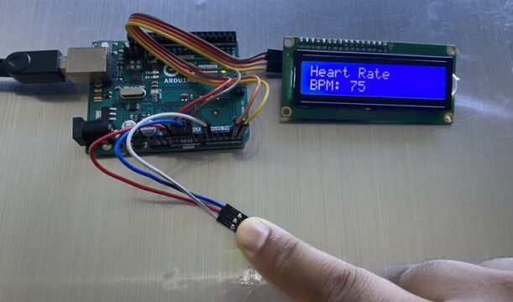
TESTING & RESULTS UPLOADING THE CODE AND TEST THE SENSOR WORKING.

Slide 18
APPLICATIONS
SLEEP TRACKING
ANXIETY MONITORING
REMOTE PATIENT MONITORING OR ALARM SYSTEM
HEALTH BANDS
COMPLEX GAMING CONSOLES

Slide 19
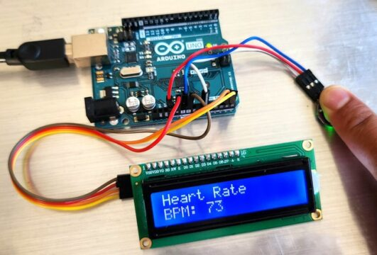
Place your finger on Pulse Sensor and you may see the BPM Value displayed on LCD Screen.

Slide 20
REFERENCES
1) https://techatronic.com/heart-beat-sensor-using-arduino-bpm-monitor/
2)https://www.elprocus.com/pulse-sensor-working-principle-and-its-applications/
3)https://www.google.com/searchq=yutube+videos+on+pulse+rate+with+arduino&oq=yutube+videos+on+pulse+rate+with+arduino+&gs_lcrp=EgZjaHJvbWUyBggAEEUYOdIBCTEyMzAzajBqMagCALACAA&sourceid=chrome&ie=UTF-8#
4)https://www.google.com/searchq=yutube+videos+on+pulse+rate+with+arduino&oq=yutube+videos+on+pulse+rate+with+arduino+&gs_lcrp=EgZjaHJvbWUyBggAEEUYOdIBCTEyMzAzajBqMagCALACAA&sourceid=chrome&ie=UTF-8#
5)
https://www.google.com/searchq=yutube+videos+on+pulse+rate+with+arduino&oq=yutube+videos+on+pulse+rate+with+arduino+&gs_lcrp=EgZjaHJvbWUyBggAEEUYOdIBCTEyMzAzajBqMagCALACAA&sourceid=chrome&ie=UTF-8#
6)
https://www.google.com/search?q=yutube+videos+on+pulse+rate+with+arduino&oq=yutube+videos+on+pulse+rate+with+arduino+&gs_lcrp=EgZjaHJvbWUyBggAEEUYOdIBCTEyMzAzajBqMagCALACAA&sourceid=chrome&ie=UTF-8#

Slide 21
7)https://www.google.com/searchq=yutube+videos+on+pulse+rate+with+arduino&oq=yutube+videos+on+pulse+rate+with+arduino+&gs_lcrp=EgZjaHJvbWUyBggAEEUYOdIBCTEyMzAzajBqMagCALACAA&sourceid=chrome&ie=UTF-8#

Slide 22
CODE FOR ARDUINO UNO
#define USE_ARDUINO_INTERRUPTS true // Set-up low-level interrupts for most acurate BPM math.
#include <PulseSensorPlayground.h> // Includes the PulseSensorPlayground Library.
#include <Wire.h>
#include <LCD.h>
#include <LiquidCrystal_I2C.h> // F Malpartida's NewLiquidCrystal library
#define I2C_ADDR 0x27 // Define I2C Address for controller
#define En_pin 2
#define Rw_pin 1
#define Rs_pin 0
#define D4_pin 4
#define D5_pin 5
#define D6_pin 6
#define D7_pin 7
#define BACKLIGHT 3

Slide 23
LiquidCrystal_I2C lcd(I2C_ADDR,En_pin,Rw_pin,Rs_pin,D4_pin,D5_pin,D6_pin,D7_pin);
// Variables
const int PulseWire = 0; // PulseSensor PURPLE WIRE connected to ANALOG PIN 0
const int LED13 = 13; // The on-board Arduino LED, close to PIN 13.
int Threshold = 550; // Determine which Signal to "count as a beat" and which to ignore.
// Use the "Gettting Started Project" to fine-tune Threshold Value beyond default setting.
// Otherwise leave the default "550" value.
PulseSensorPlayground pulseSensor; // Creates an instance of the PulseSensorPlayground object called "pulseSensor"
void setup() {
Serial.begin(9600); // For Serial Monitor
lcd.begin(20,4);
lcd.setBacklightPin(BACKLIGHT,POSITIVE);
lcd.setBacklight(HIGH);

Slide 24
// Configure the PulseSensor object, by assigning our variables to it.
pulseSensor.analogInput(PulseWire);
pulseSensor.blinkOnPulse(LED13); //auto-magically blink Arduino's LED with heartbeat.
pulseSensor.setThreshold(Threshold);
// Double-check the "pulseSensor" object was created and "began" seeing a signal.
if (pulseSensor.begin()) {
Serial.println("We created a pulseSensor Object !"); //This prints one time at Arduino power-up, or on Arduino reset.
lcd.setCursor(0,0);
lcd.print(" Heart Rate Monitor");
}
}
void loop() {

Slide 25
int myBPM = pulseSensor.getBeatsPerMinute(); // Calls function on our pulseSensor object that returns BPM as an "int".
// "myBPM" hold this BPM value now.
if (pulseSensor.sawStartOfBeat()) { // Constantly test to see if "a beat happened".
Serial.println(" A HeartBeat Happened ! "); // If test is "true", print a message "a heartbeat happened".
Serial.print("BPM: "); // Print phrase "BPM: "
Serial.println(myBPM); // Print the value inside of myBPM.
lcd.setCursor(0,2);
lcd.print("HeartBeat Happened !"); // If test is "true", print a message "a heartbeat happened".
lcd.setCursor(5,3);
lcd.print("BPM: "); // Print phrase "BPM: "
lcd.print(myBPM);
}
delay(20); // considered best practice in a simple sketch.
}

Slide 26
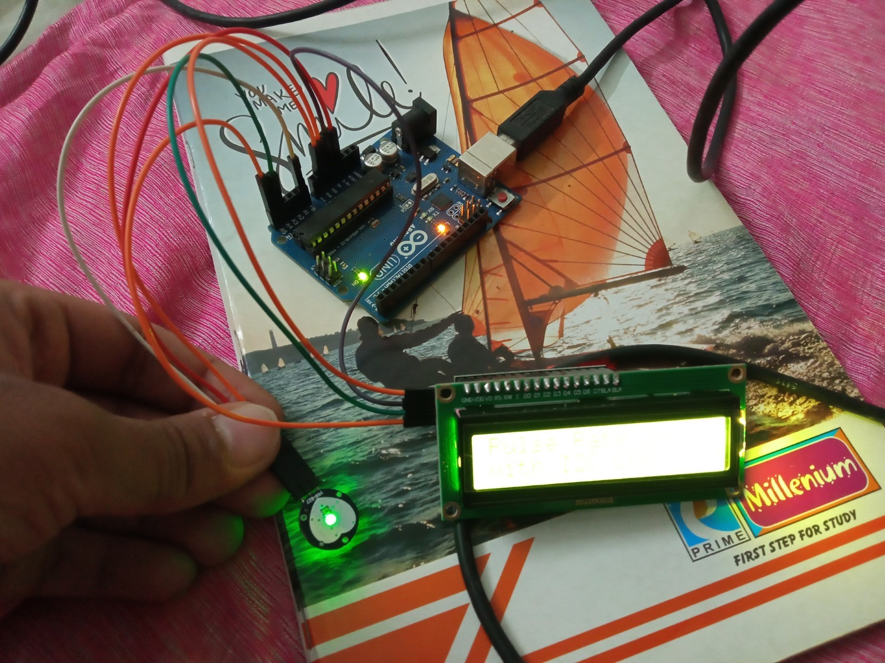
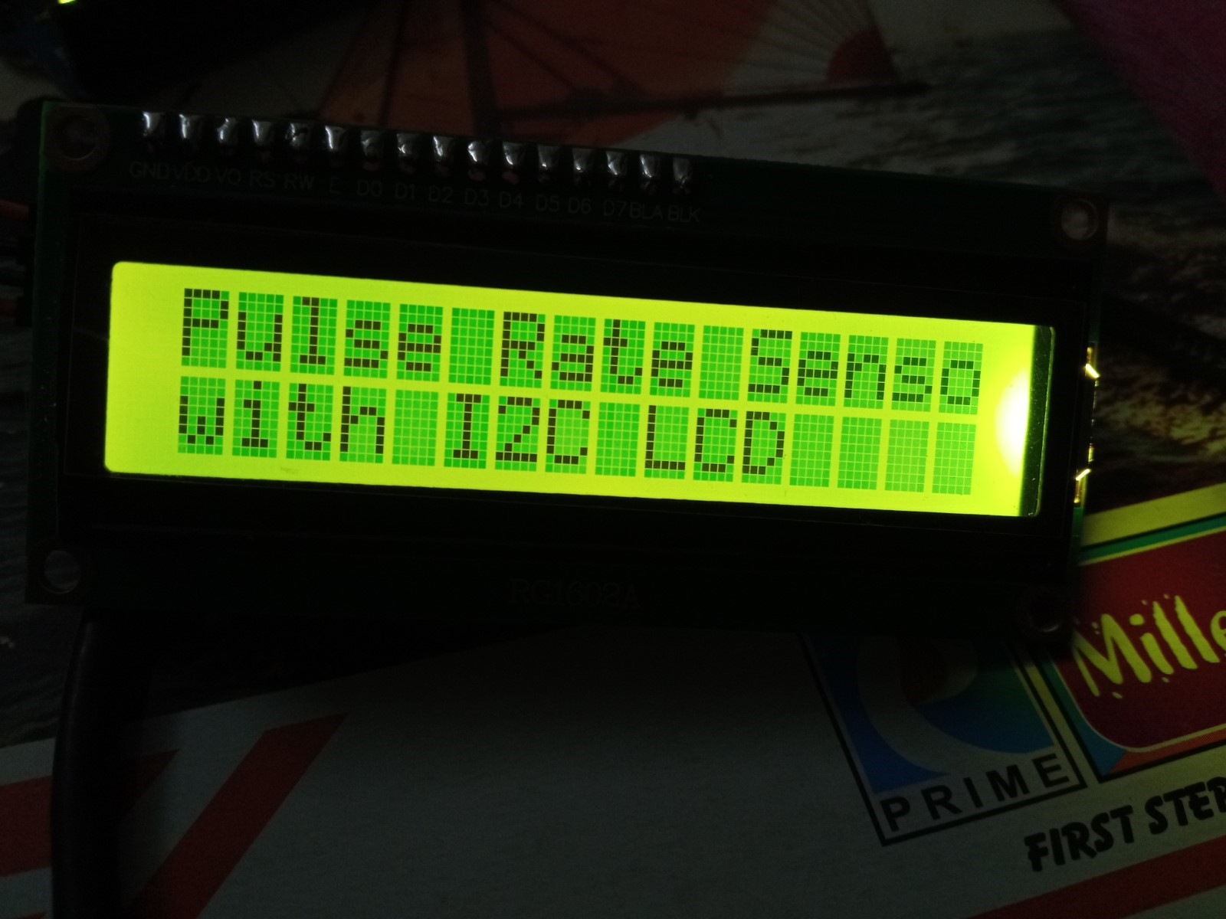
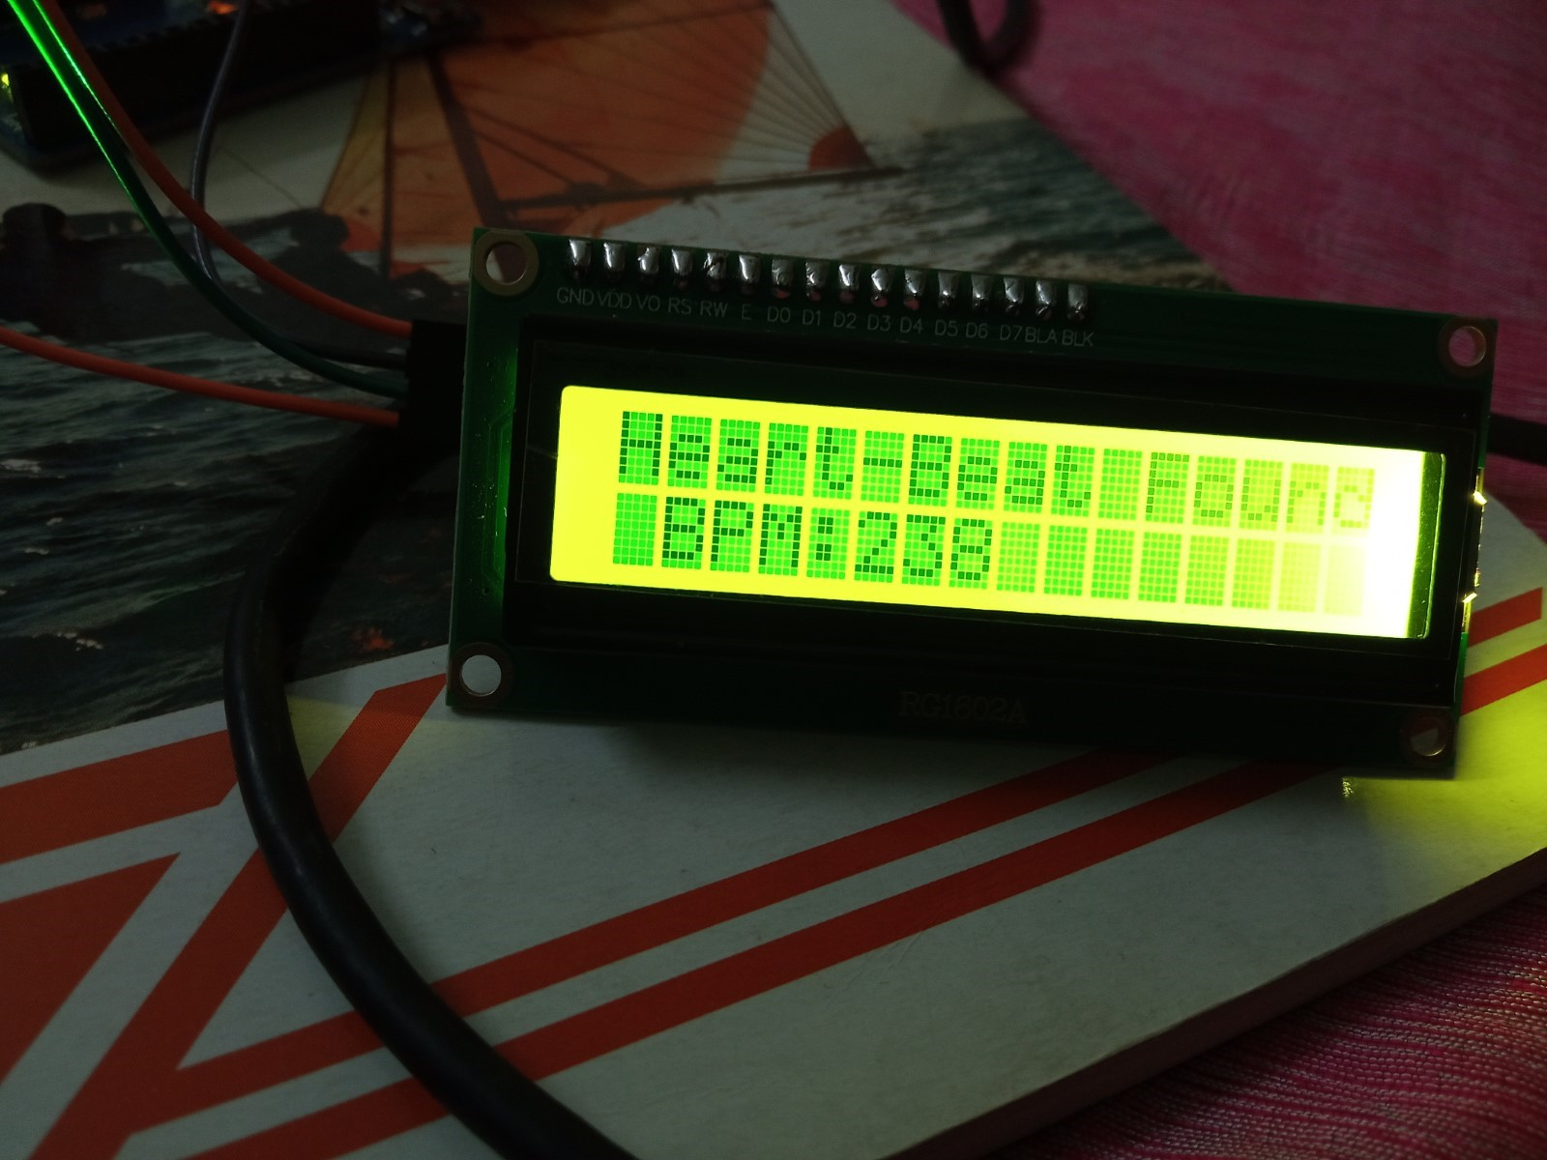
WORKING PROJECT RESULTS

Slide 27
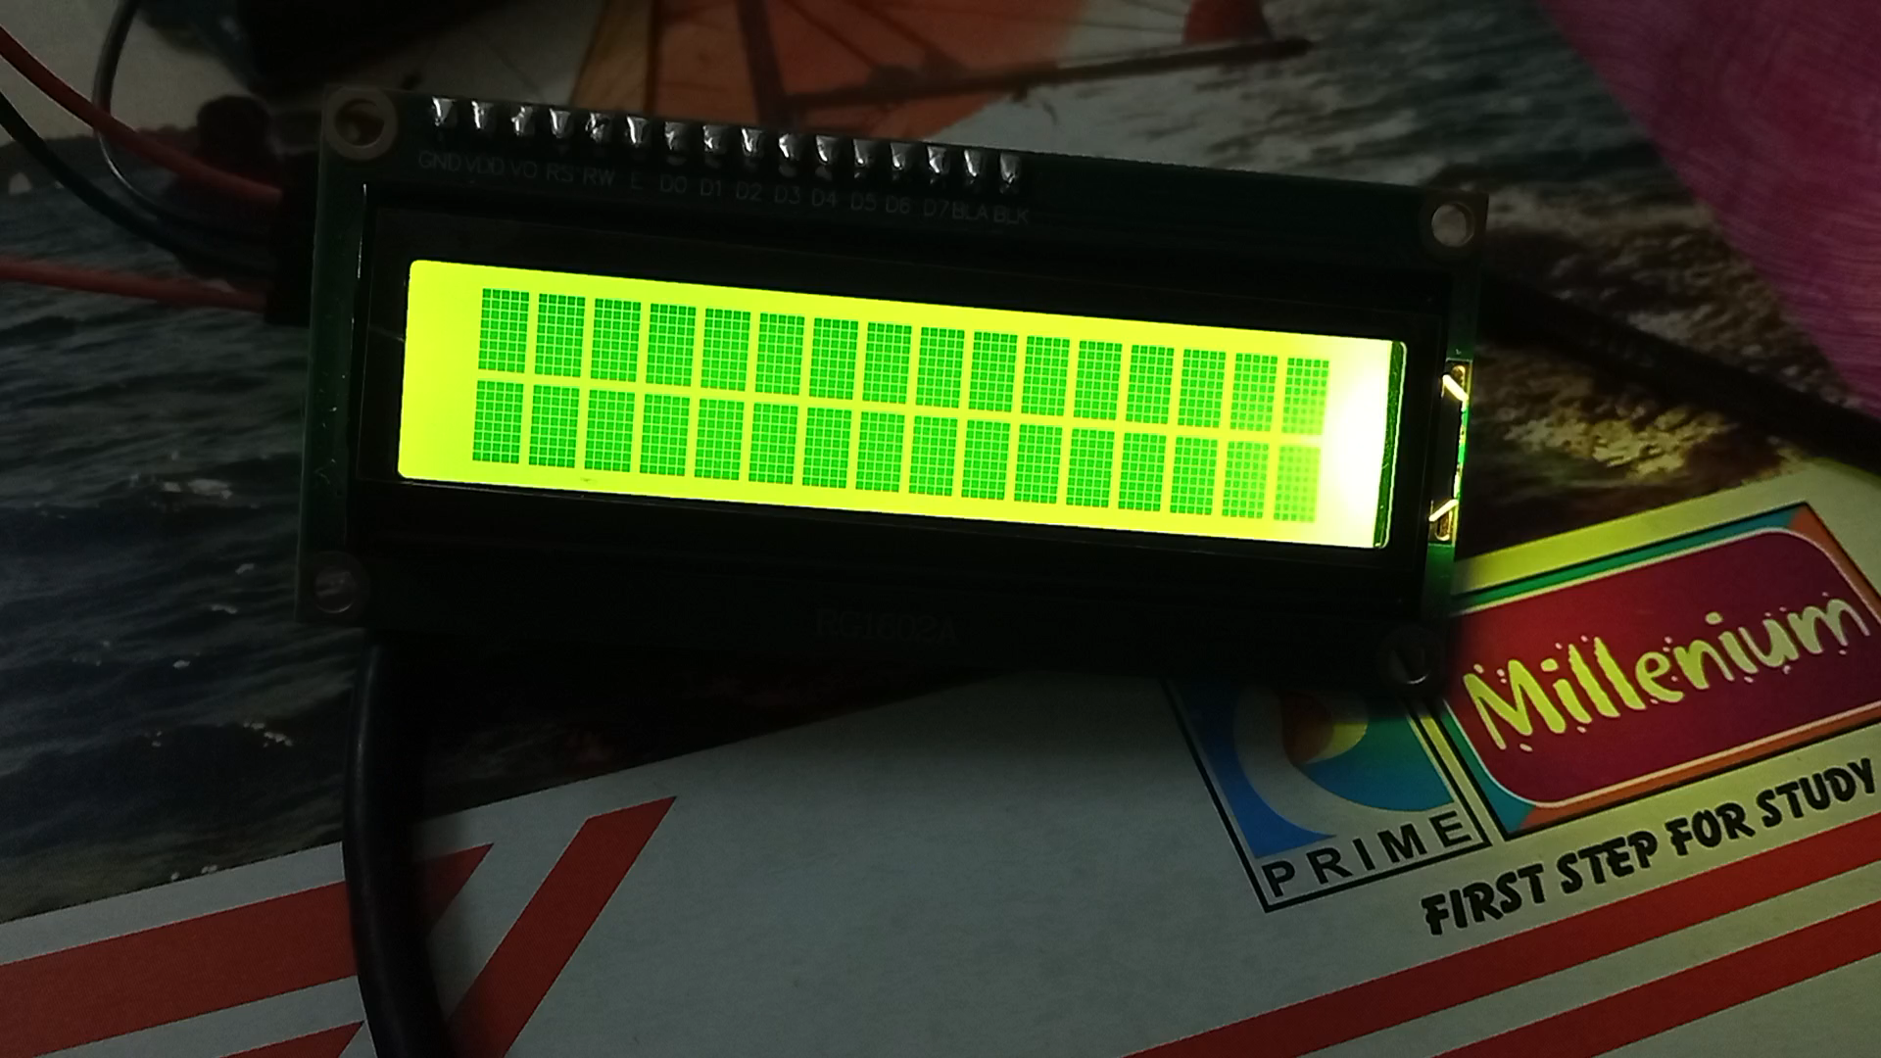

Slide 28
CONCLUSION
The step-by-step process of creating a Pulse Rate Monitor using an Arduino and a Pulse Sensor. This project is not only educational but also highly practical, offering a cost-effective solution for monitoring your heart rate in real-time. Whether you’re a healthcare professional, a fitness enthusiast, or simply curious about electronics, this project provides valuable insights into both health monitoring and Arduino programming.

Slide 29
THANK YOU
x

